Slide 1
Meta Scifor Ai/mL
Mini Project 1
By Yash Dinesh Khatwani

Slide 2
Step 1
import pandas as pd
import numpy as np
import seaborn as sns
import matplotlib.pyplot as plt
First I imported all the important libraries like pandas which is used for data analysis and maniupulation.
I also imported numpy which is used for calculations and conducting numerical operations.
Seaborn is another library it helps in simplifying data visualization.
Matplotlib is used to create various plots and analytical representations of data.

Slide 3
. Step 2
. data=pd.read_csv("file:///Users/yashkhatwani/Downloads/medical_cost_insurance/medical_cost_insurance.csv")
data.shape
data.describe()
. I then took the path of the dataset and used pd.read_csv in my juipter notebook for Juipter notebook to understand the dataset.
. After this I used data.shape and data.describe() to see the number of rows and columns in my dataset and to check if there are any null values.

Slide 4
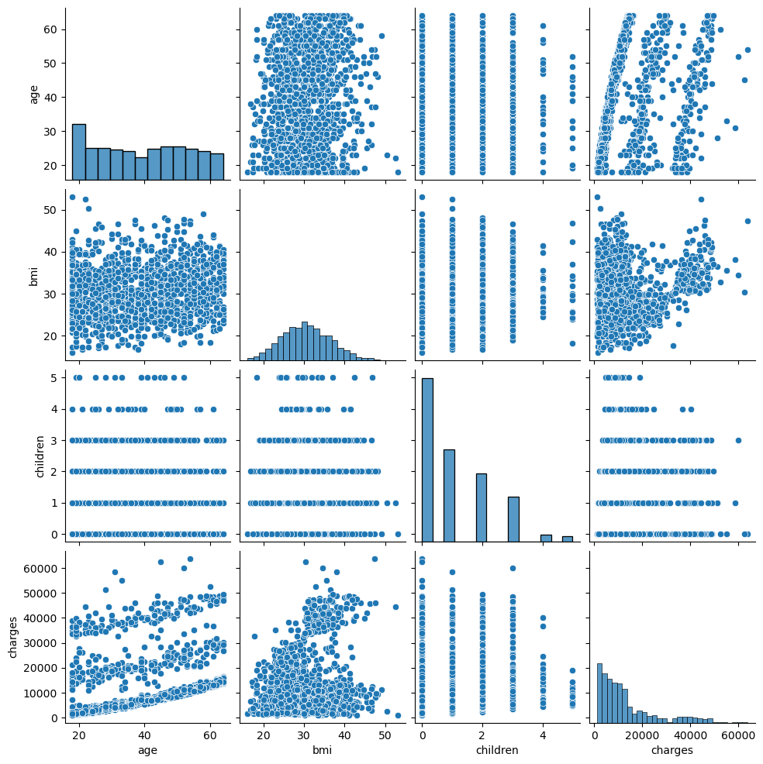
Step 3
sns.pairplot(data)
plt.show()

Slide 5
Step 4
. from sklearn.model_selection import train_test_split
X = data.drop(columns=['charges’])
y = data['charges’]
X_train, X_test, y_train, y_test = train_test_split(X, y, test_size=0.2, random_state=42)
. In this step I split the data into X test Y test and X train and Y train .
. I then assigned charges as the predictive variable as that’s what is needed to be calculated through the course of this project.

Slide 6
Step 5
. from sklearn.pipeline import Pipeline
from sklearn.linear_model import LinearRegression
from sklearn.compose import ColumnTransformer
from sklearn.preprocessing import StandardScaler, OneHotEncoder
numerical_features = ['age', 'bmi', 'children']
categorical_features = ['sex', 'smoker', 'region']
preprocessor = ColumnTransformer([
('num', StandardScaler(), numerical_features),
('cat', OneHotEncoder(drop='first'), categorical_features)
])
model = Pipeline([
('preprocessor', preprocessor),
('regressor', LinearRegression())
])
. At this step I divided the variables into categorical and numerical and performed linear regression.

Slide 7
Step 6
. from sklearn.metrics import mean_absolute_error,
mean_squared_error, r2_score
mae=mean_absolute_error(y_test,y_pred)
mse=mean_squared_error(y_test,y_pred)
rmse=np.sqrt(mse)
r2=r2_score(y_test,y_pred)
. After this I checked the efficiency and how my model performs
using some important metrics like r2 score.
. I got a score of 0.78 which indicates that it is a good
model.

